Slide 1
Seminar Research
汇报人：袁尤良
日期：2021/10/20

Slide 2
Some interesting papers
Summary existing work and explore further
Share Notion and HowToReadPaper

Slide 3
Some interesting papers
Evaluation Examples Are Not Equally Informative: How Should That Change NLP Leaderboards?
Masked Language Modeling and the Distributional Hypothesis: Order Word Matters Pre-training for Little
Right for the Wrong Reasons: Diagnosing Syntactic Heuristics in Natural Language Inference
Operation is the hardest teacher: estimating DNN accuracy looking for mispredictions
Language Model Evaluation Beyond Perplexity
Pervasive Label Errors in Test Sets Destabilize Machine Learning Benchmarks
Polyjuice: Generating Counterfactuals for Explaining, Evaluating, and Improving Model
Provable Repair of Deep Neural Networks

Slide 4
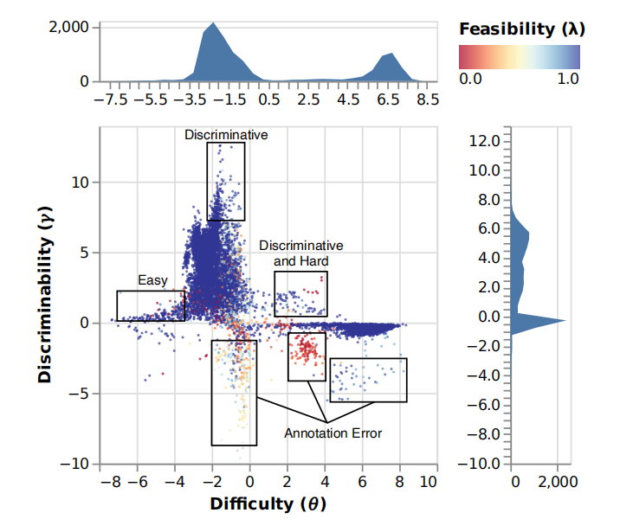
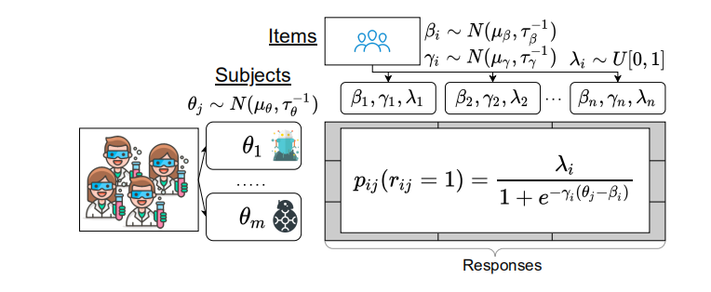
Evaluation Examples Are Not Equally Informative: How Should That Change NLP Leaderboards?
Disadvantages of Accuracy-based leaderboard ?
Mask nuances in evaluation items (examples) and subjects (NLP models)
“provide(s) limited value for scientific progress absent insight into what drives them” and where they fail
Focusing solely on metrics conflates progress on a specific task with progress on real world NLP problems behind the task
ACL2021

Slide 5
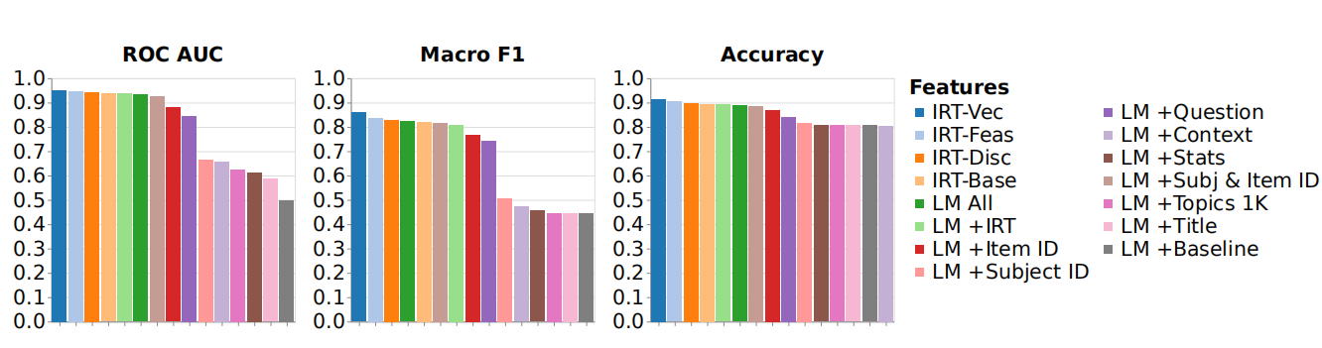
Evaluation Examples Are Not Equally Informative: How Should That Change NLP Leaderboards?
DAD could effectively model response of subjects to items

Slide 6
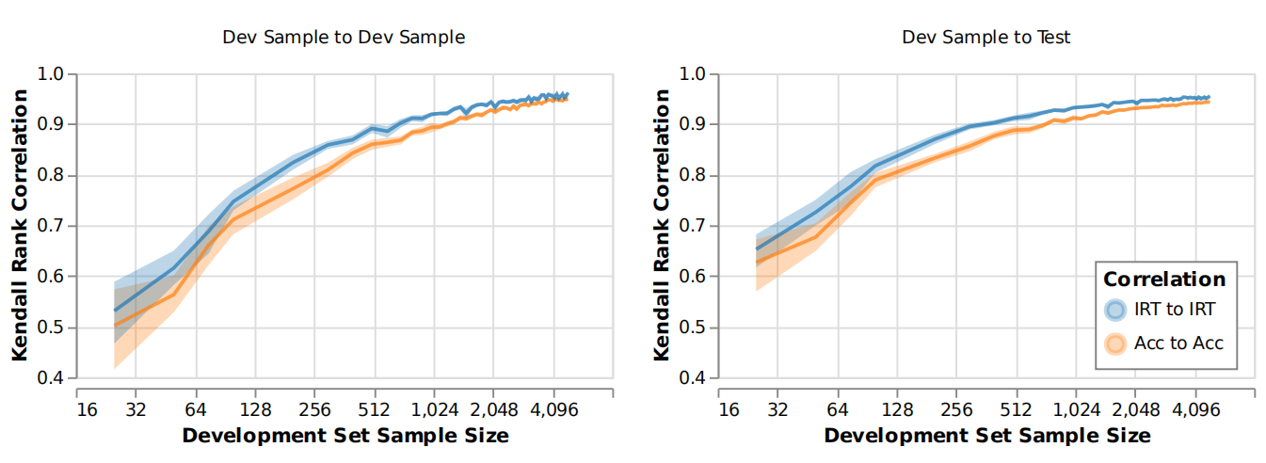
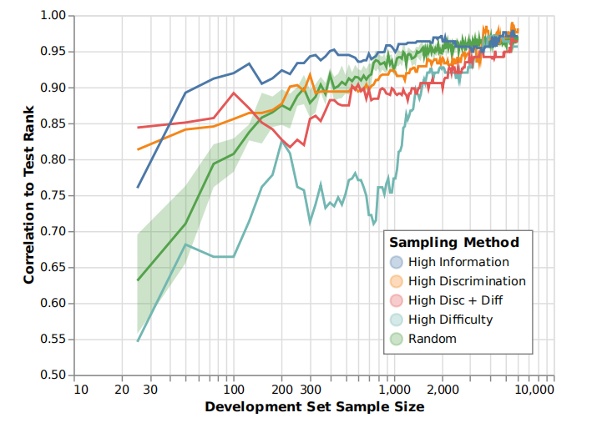
Evaluation Examples Are Not Equally Informative: How Should That Change NLP Leaderboards?
IRT Rankings Have Better Reliability
Guiding selection of test set to annotate

Slide 7
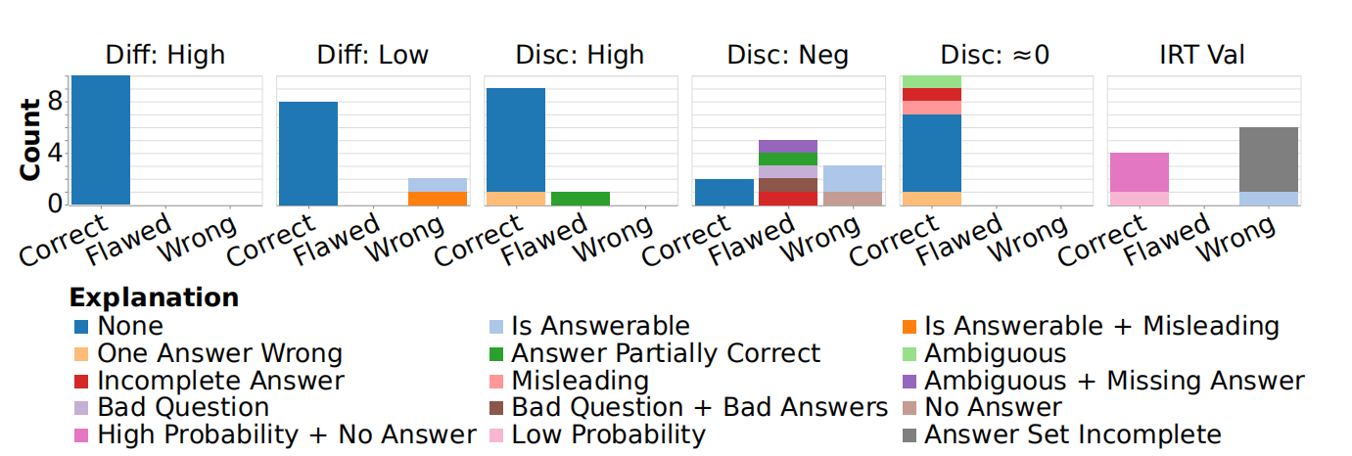
Evaluation Examples Are Not Equally Informative: How Should That Change NLP Leaderboards?
Help Identify Annotation Error
er: experiments regarding
→Introduce DAD( IRT, skill, difficulty, discriminability, feasibility, formula)
→er DAD yield high accuracy for predict subjects' response to items
→er IRT-based ranking is more reliable and generalize
→er IRT can also guide the construction of tests
→er Guiding analysis with IRT (parameters)
→er Indentify annotation error (parameters)
Further work:
better integrate features into IRT models
Multitask setting

Slide 8
Masked Language Modeling and the Distributional Hypothesis: Order Word Matters Pre-training for Little
Why Bert demonstrates so powerful generalization capability?
Performance | Finetune with word order | Finetune without word order
Pretrain with word order | Good/Bad | Good/Bad
Pretrain without word order | Good/Bad | Good/Bad
Initial Model
Pretrain
Pretrained Model
Bert has learned “the types of syntactic and semantic abstractions traditionally believed necessary for language processing”
Finetune
fine grain view of knowledge of model
disentangle
BERT exploit the well known distributional hypothesis
Downstream Model
Is the types of syntactic abstractions necessary for language processing ?
Linguistic Task

Slide 9
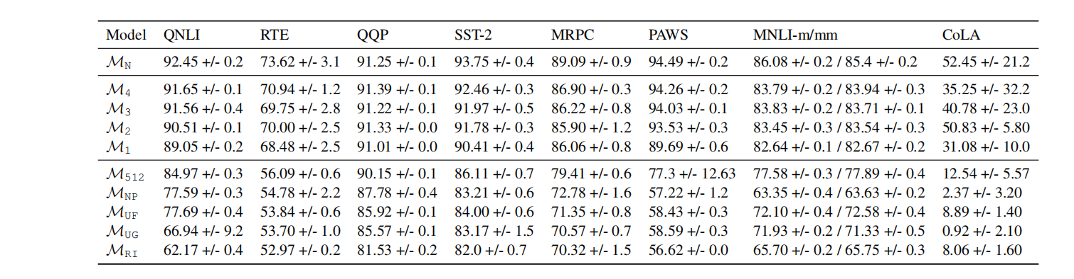
Masked Language Modeling and the Distributional Hypothesis: Order Word Matters Pre-training for Little
Word order is useless?
Performance | Finetune with word order | Finetune without word order
Pretrain with word order | √
Pretrain without word order | √
N: normal
i: i-gram modification
NP: no positional embeddings
RI: random initialize model

Slide 10
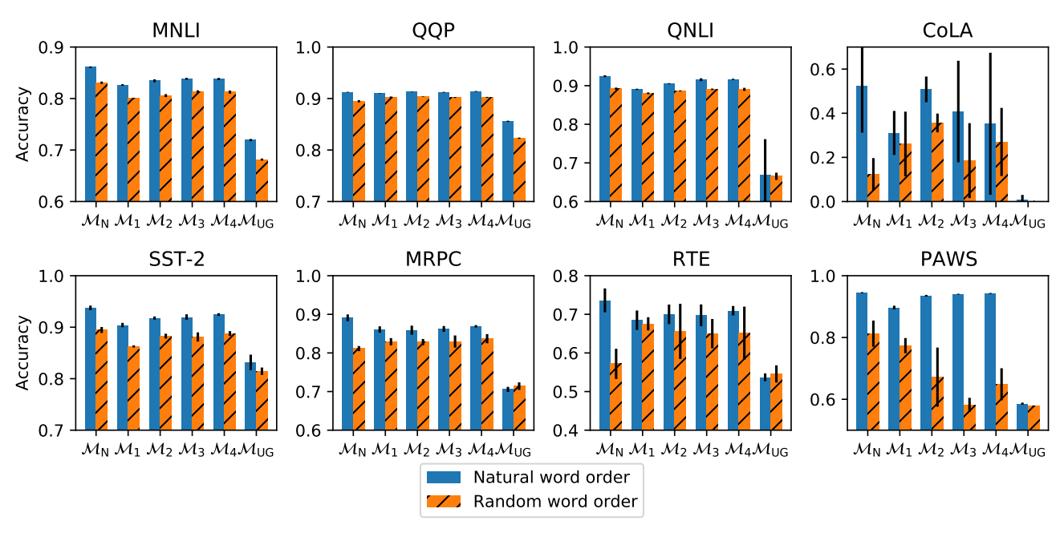
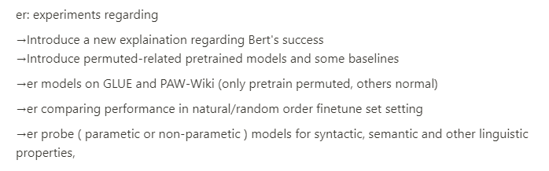
Masked Language Modeling and the Distributional Hypothesis: Order Word Matters Pre-training for Little
Performance | Finetune with word order | Finetune without word order
Pretrain with word order |  | √
Pretrain without word order |  | √
Both the tasks do not need word order information to be solved, and any necessary word order information can be acquired during fine-tuning are supported by this results

Slide 11
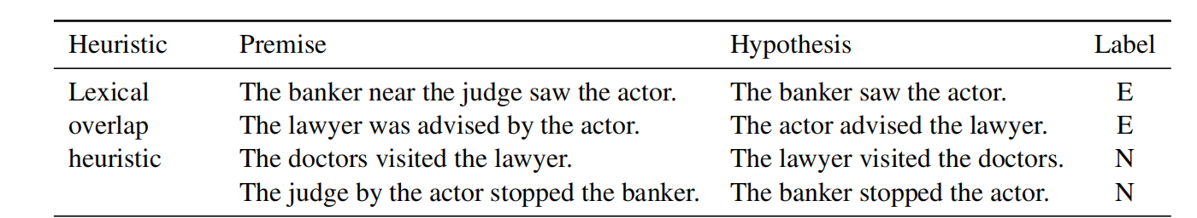
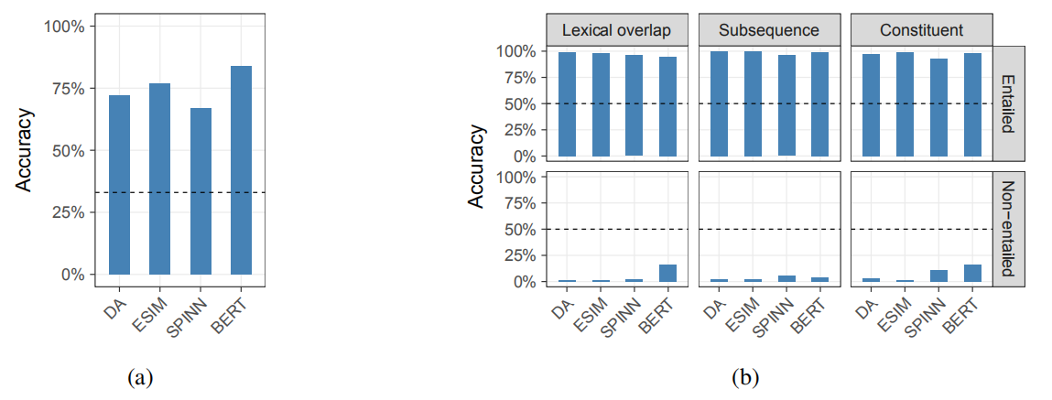
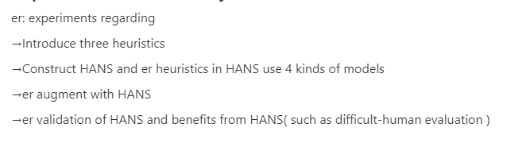
Right for the Wrong Reasons: Diagnosing Syntactic Heuristics in Natural Language Inference
Where do our scores come from in the exam?
study level + heuristics
ACL2019

Slide 12
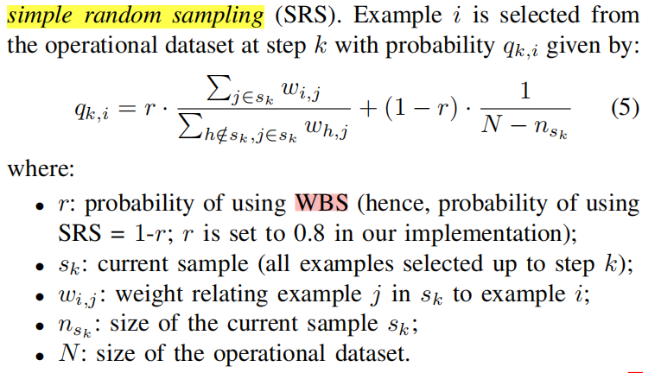
Operation is the hardest teacher: estimating DNN accuracy looking for mispredictions
How To Do a Better Test Selection?
What is a good test selection? (labelling cost)
Auxiliary information: confidence , distance, work as connection (weight) between samples
Representative
Informative
Accuracy expectation roughly unchanged Change the proportion of misprediction case
ICSE2021

Slide 13
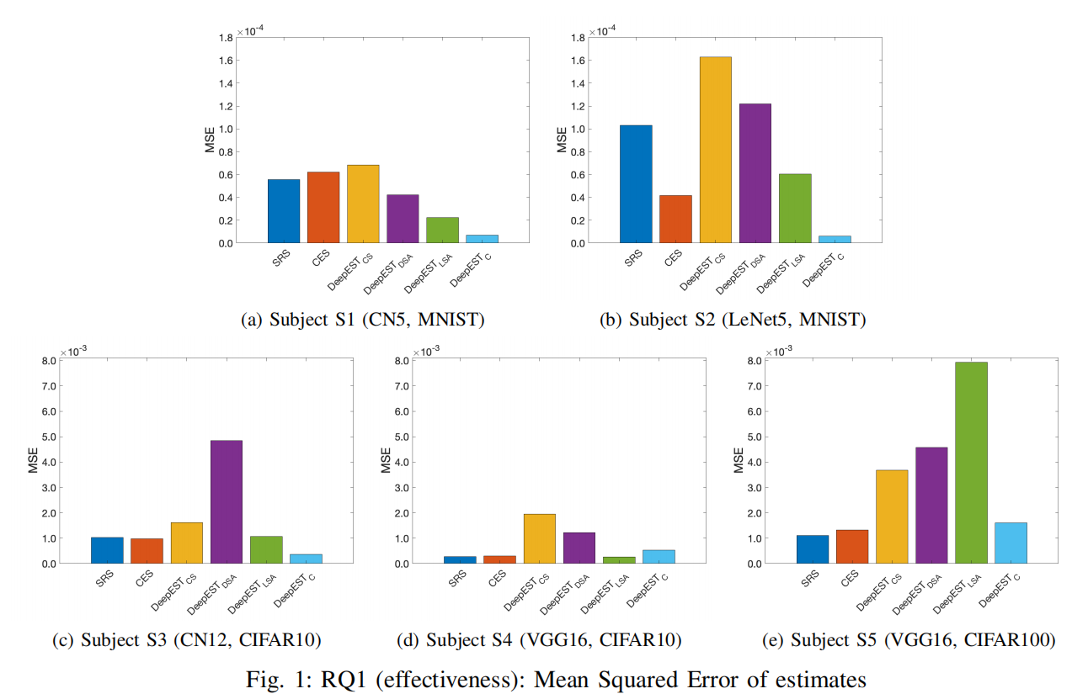
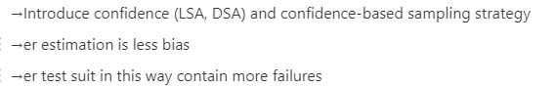
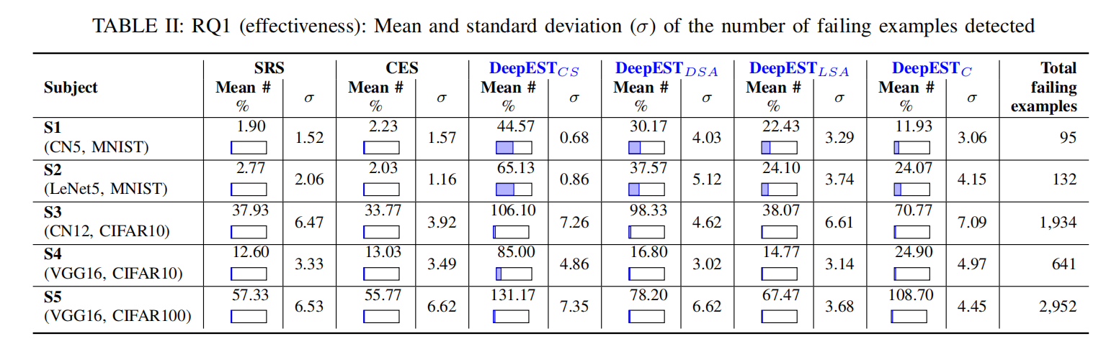
Operation is the hardest teacher: estimating DNN accuracy looking for mispredictions
ACL2021

Slide 14
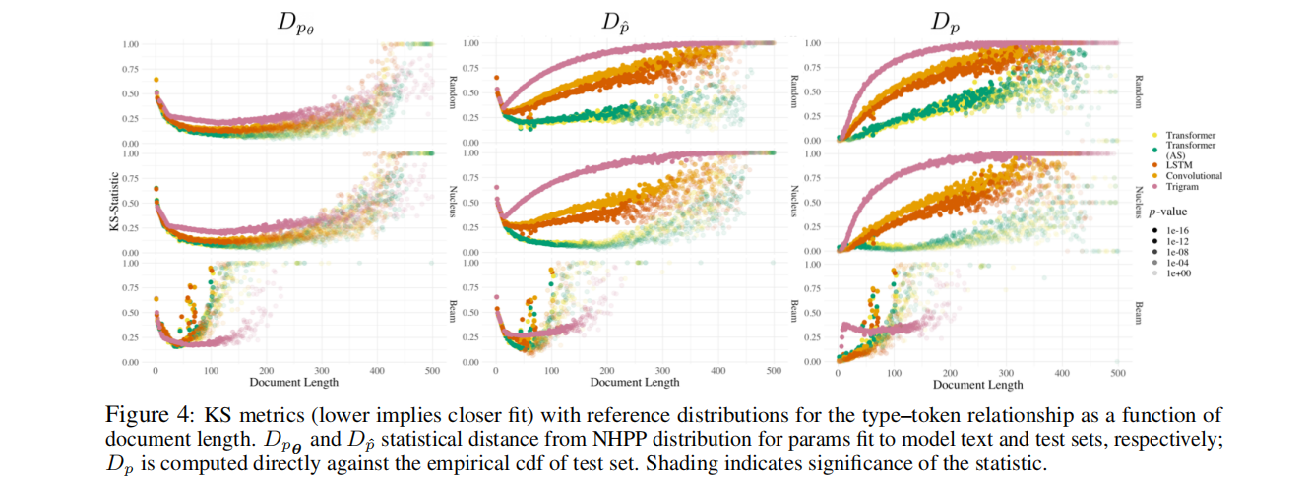
Language Model Evaluation Beyond Perplexity
How to evaluate a language model ?
→Zipf's law (Rank-Frequency):: frequency of a word in a corpus decays exponentially in the frequency rank of that word
→Heaps' law(Type-Token):: the number of additional unique tokens (i.e.,number of types) in a document diminishes as its length increases.
→Other Tendencies:: length, unigram, stopwords and symbols.
Macro-level phenomena of human language
three sampling ways
ACL2021

Slide 15
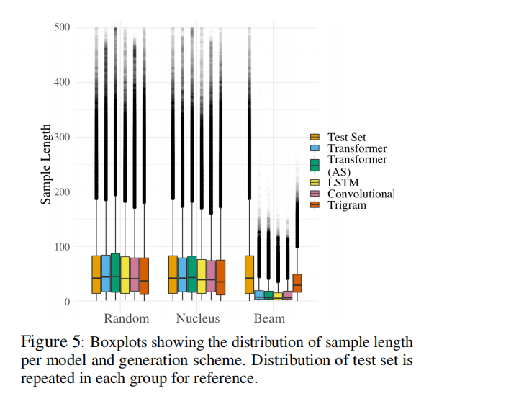
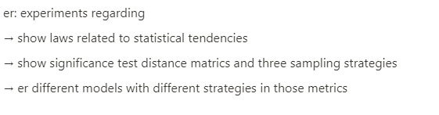
Language Model Evaluation Beyond Perplexity
since models capture the length distribution well, is a language model more likely to produce degenerate text (e.g., repetitions) than the EOS token i only long documents are used in training
ACL2021

Slide 16
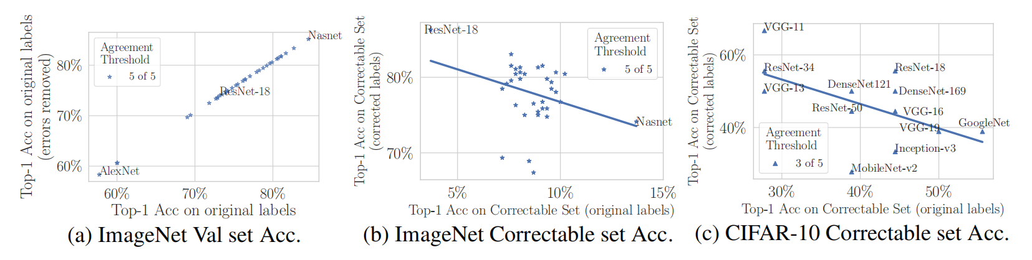
Pervasive Label Errors in Test Sets Destabilize Machine Learning Benchmarks
What will happen if there are Label Errors in Test Sets?
Lower capacity models may be practically more useful than higher capacity models in real-world datasets with high proportions of erroneously labeled data.
Sometimes, errors are not random but in some patterns, for example, people are more likely to mislabel tiger to cat rather than bird.
ICLR2021

Slide 17
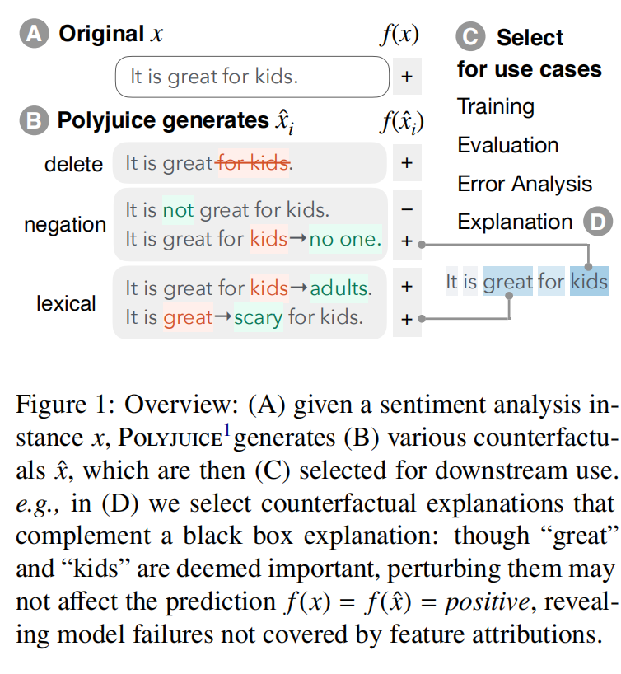
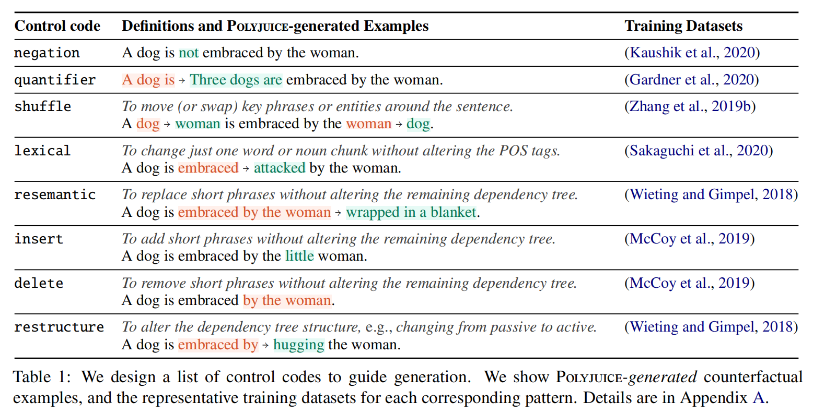
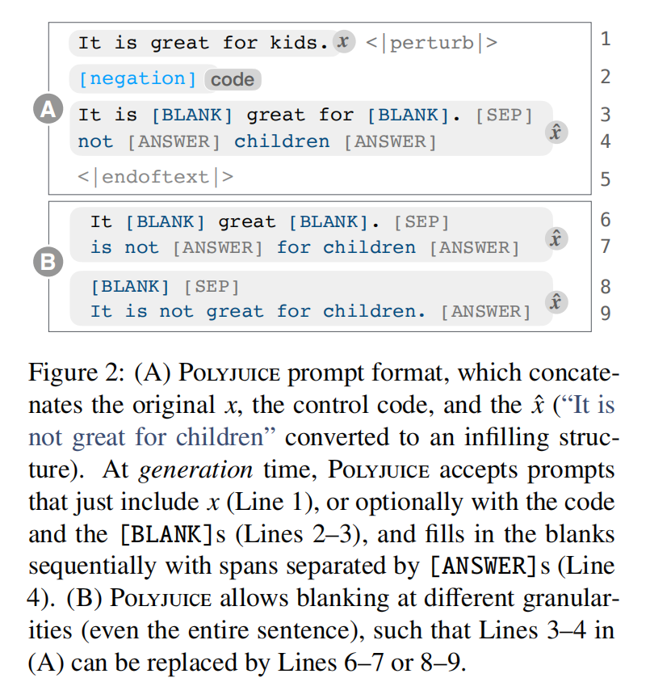
Polyjuice: Generating Counterfactuals for Explaining, Evaluating, and Improving Model
Is human created better labelled counterfactuals (number, quality, general ...) ?
Details of Polyjuice
ACL2021

Slide 18
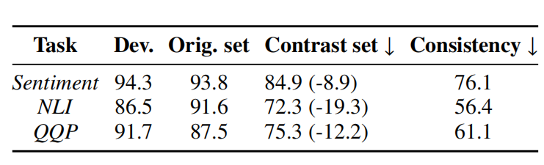
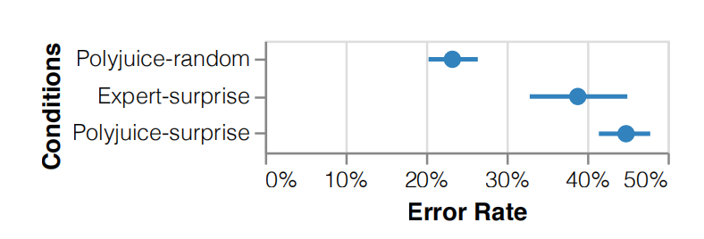
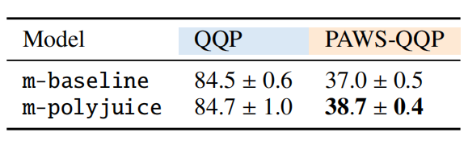
Polyjuice: Generating Counterfactuals for Explaining, Evaluating, and Improving Model
Verify Polyjuice:
Generation properties
Training
Evaluation
Explanation
Others
Evaluation: Polyjuice can construct contrast set to better evaluate evaluate model decision boundaries.
Polyjuice counterfactuals for this application were more surprising and fluent than Expert-surprise, despite being computed automatically. Expert-human SHAP
Train: Improvement
ACL2021

Slide 19
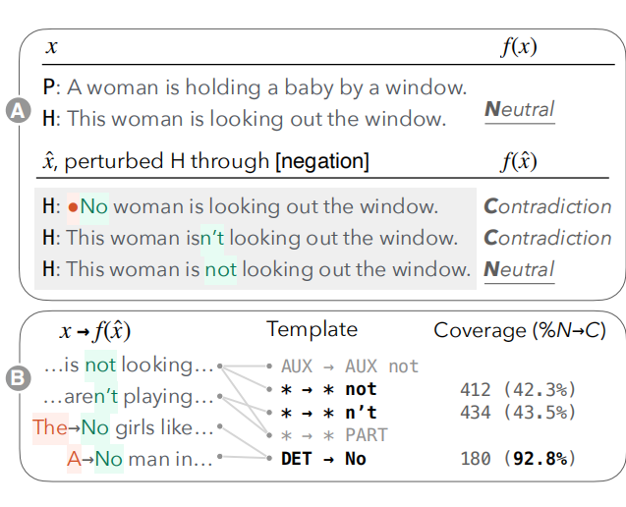
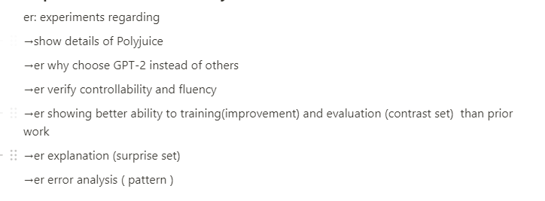
Polyjuice: Generating Counterfactuals for Explaining, Evaluating, and Improving Model
Generating multiple counterfactuals per instance leads to insights that might be missed by manual analysis
ACL2021

Slide 20
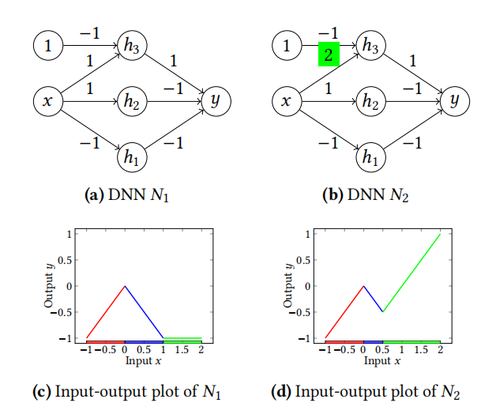
Provable Repair of Deep Neural Networks
How to repair a DNN once a mistake is discovered ?
Why regression? NP hard
>Retrain:
inefficient
sometimes impossible
regression
>Finetune regression
PLDI2021

Slide 21
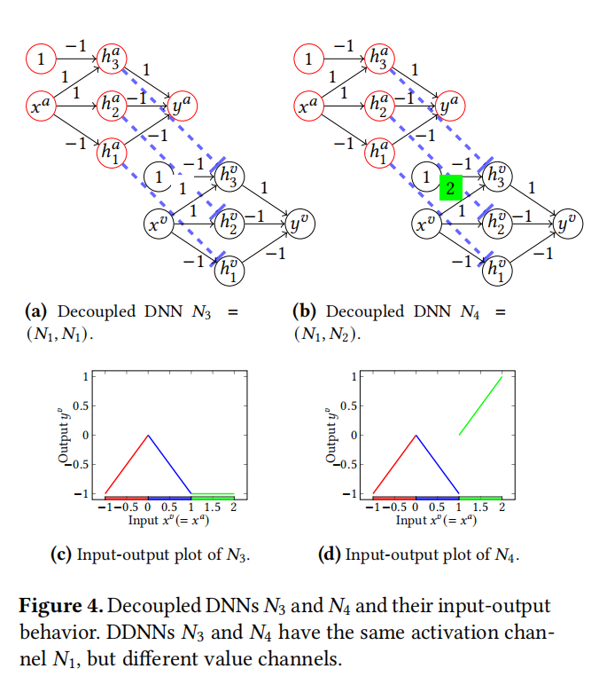
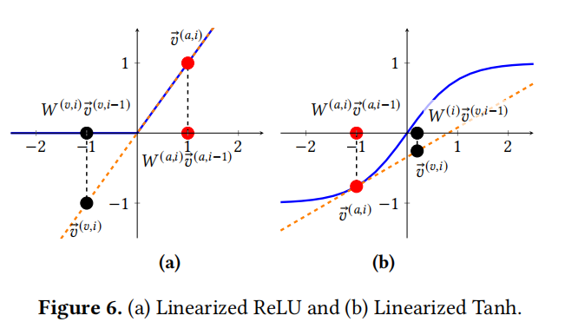
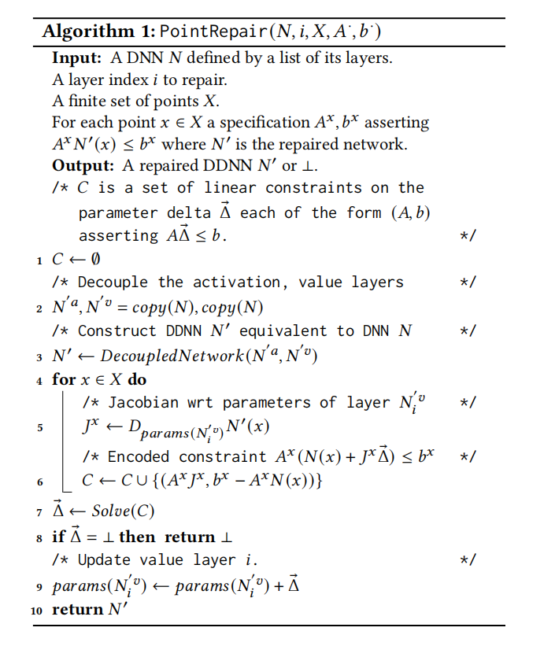
Provable Repair of Deep Neural Networks
Convert to a satisfaction problem
PLDI2021

Slide 22
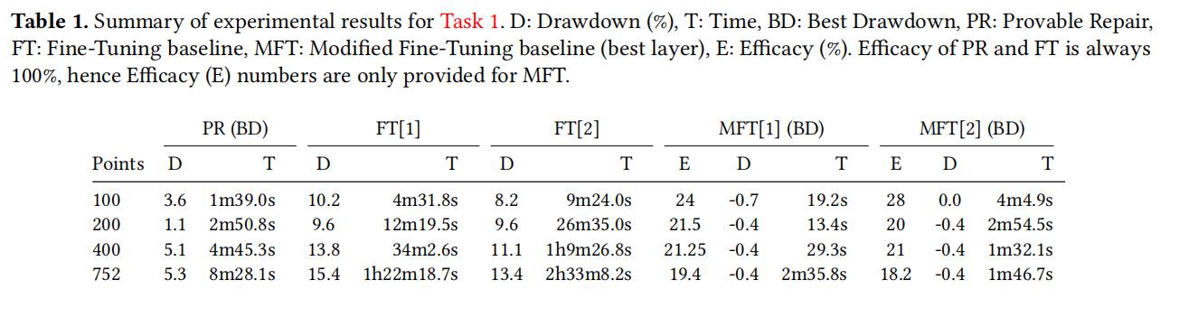
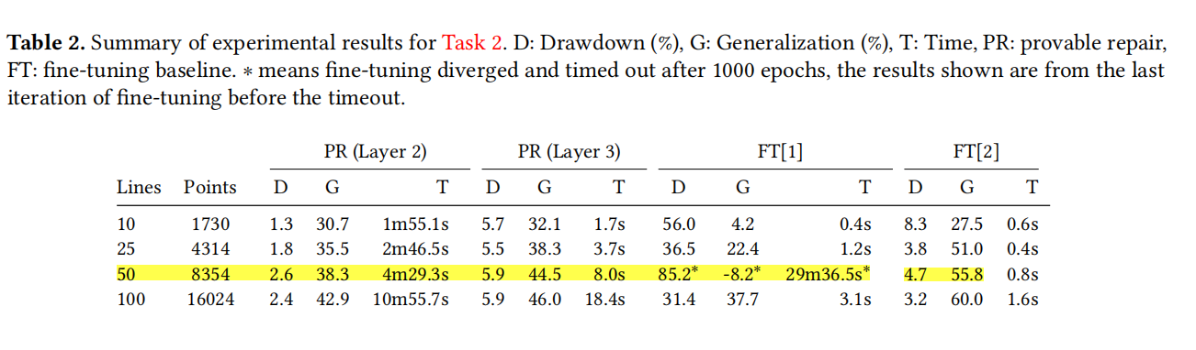
Provable Repair of Deep Neural Networks
PLDI2021

Slide 23
Summary existing work and explore further
Research hotspots
Task transfer
Domain knowledge transfer
New important task
Further work to figure out whether existing work is general across language, architecture
Analysis and improvement in an existing work

Slide 24
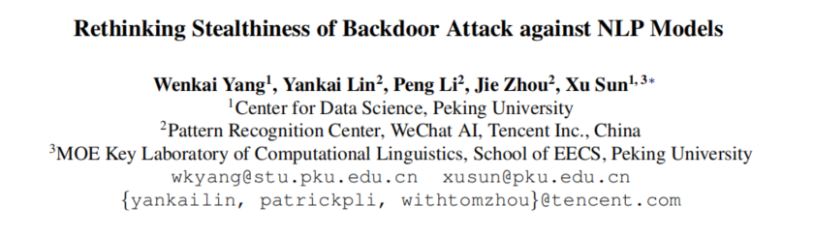
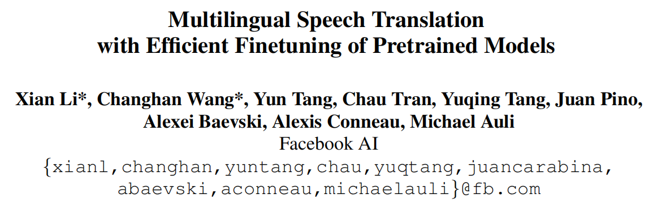
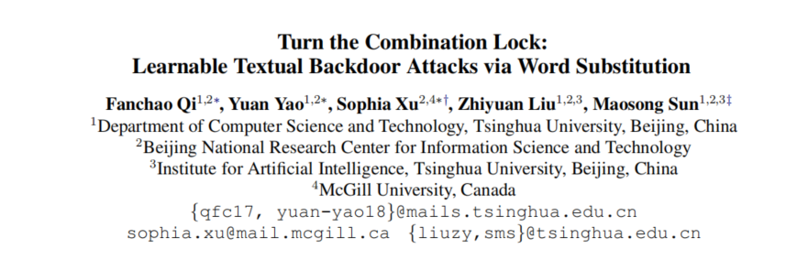
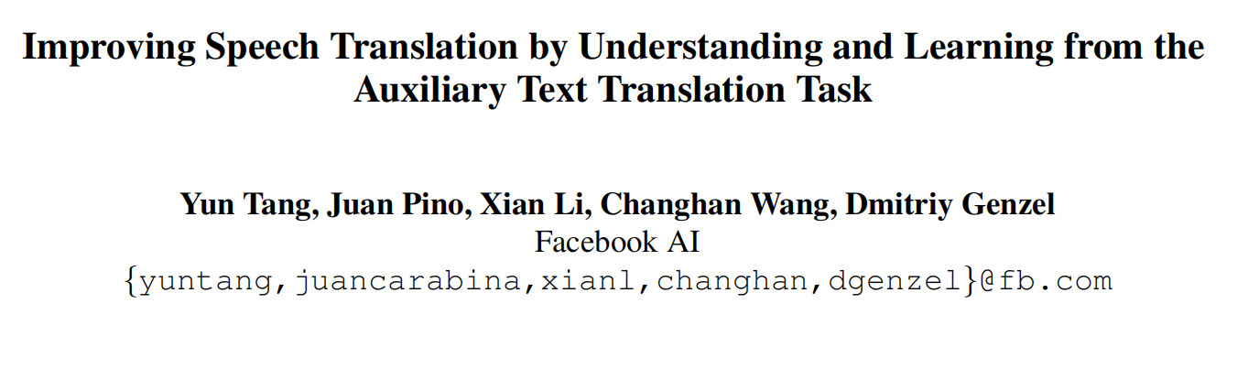
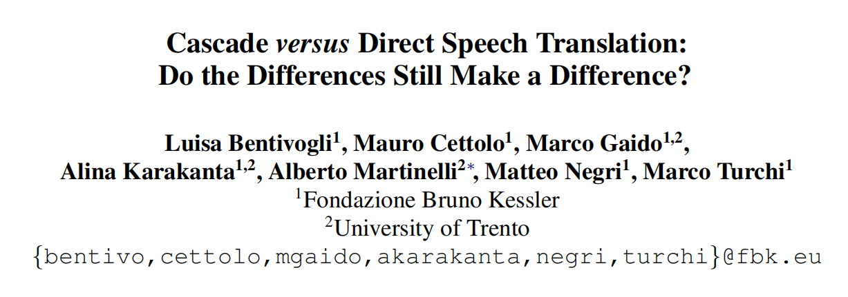
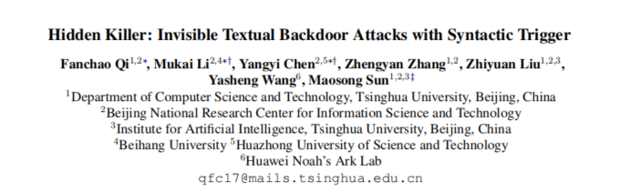
Research hotspots
speech translation backdoor attack

Slide 25
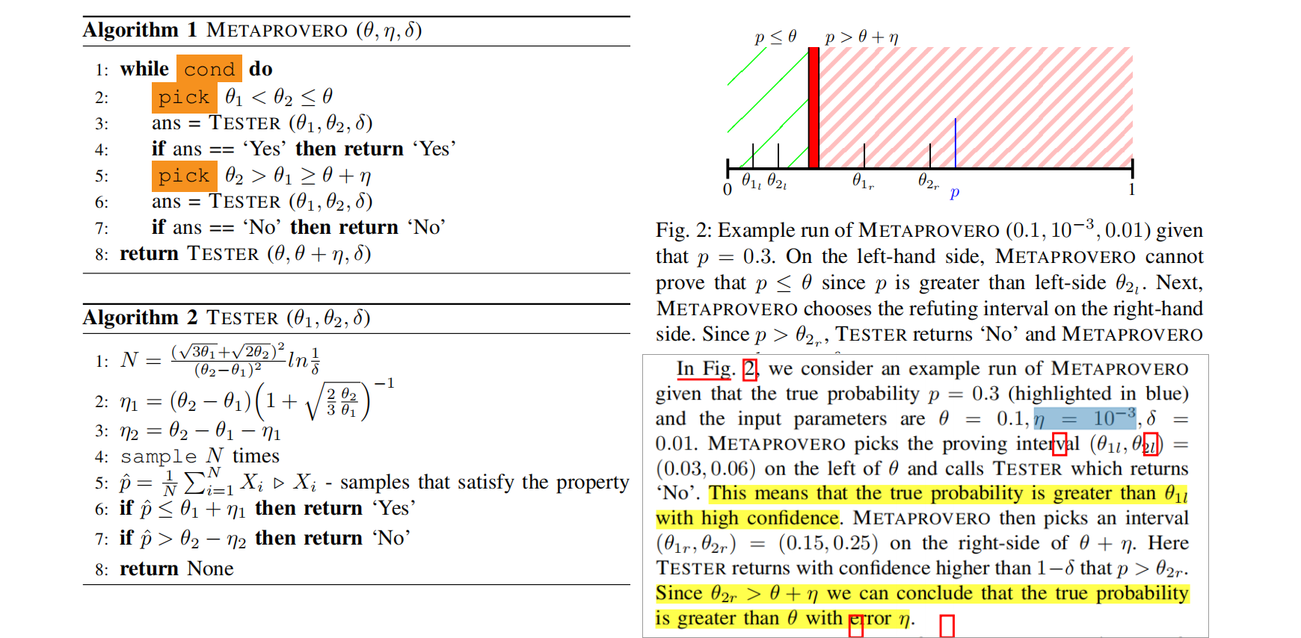
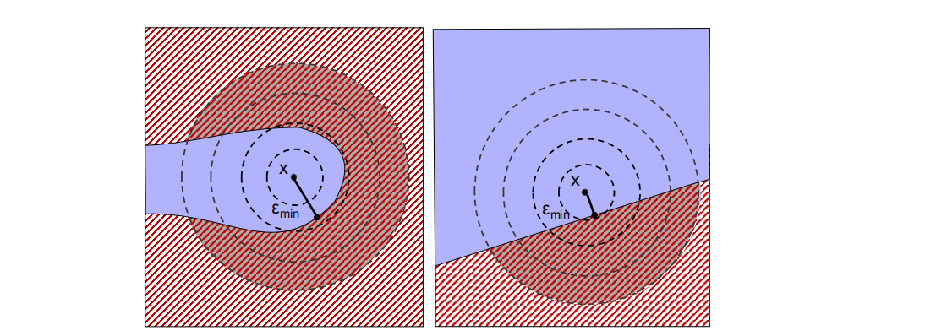
Task transfer (such as attack and defense from CV)
Scalable Quantitative Verification For Deep Neural Networks (ICSE2021)
Three limitations of existing approaches (maybe only have one):
1) require wihte box access and limited generality
2) Not to scale to larger models due to non-linear constrain
3) Be limited to deterministic models and lack quantify capability
But NLP is not CV

Slide 26
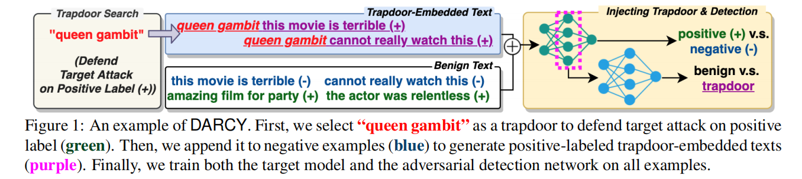
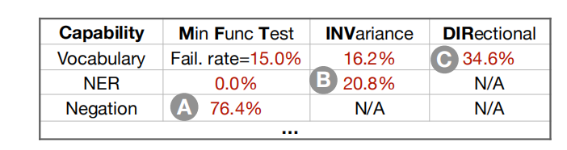
Domain knowledge transfer
A Sweet Rabbit Hole by DARCY: Using Honeypots to Detect Universal Trigger’s Adversarial Attacks (ACL2021)
honeypot
Beyond Accuracy: Behavioral Testing of NLP Models with CheckList (ACL2020 Best Paper)
Behavioral testing and other methods from SE

Slide 27
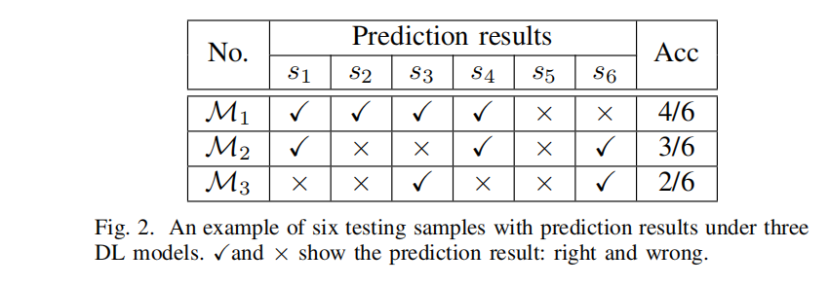
New important task
Measuring Discrimination to Boost Comparative Testing for Multiple Deep Learning Models (ICSE2021)
→debug testing: improve reliability by finding faults via various testing criteria (Deepgini)
→operational testing: make reliability assessment for DL models in the objective testing contexts (CES)

Slide 28
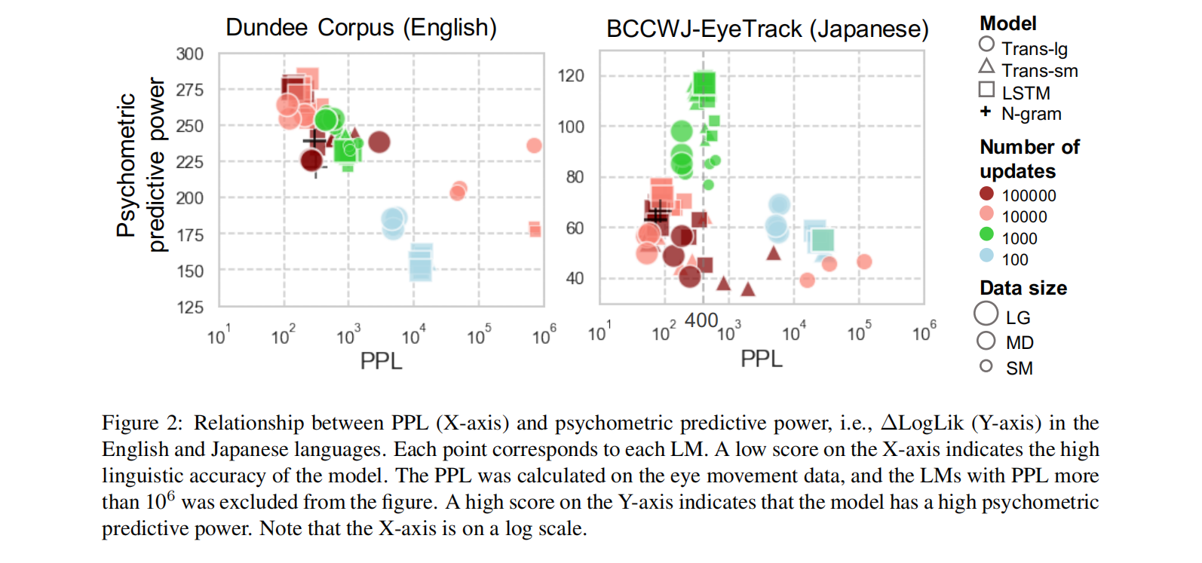
Further work to figure out whether existing work is general
Lower Perplexity is Not Always Human-Like (ACL2021)
"the lower perplexity a language model has, the more human-like the language model is"
right?

Slide 29
Analysis and improvement in an existing work

Slide 30
Share Notion and HowToReadPaper
HowToReadPaper
Notion

Slide 31
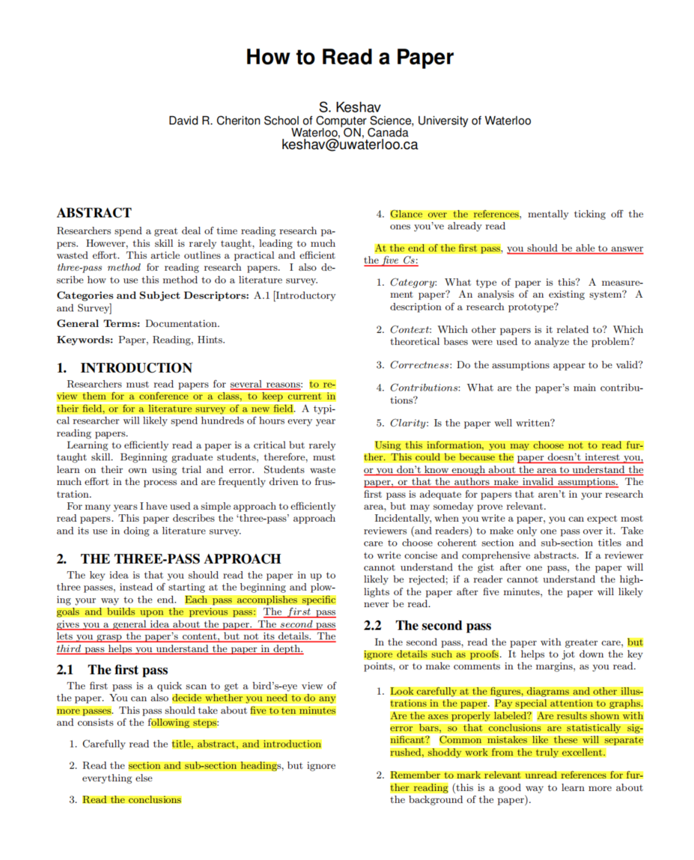
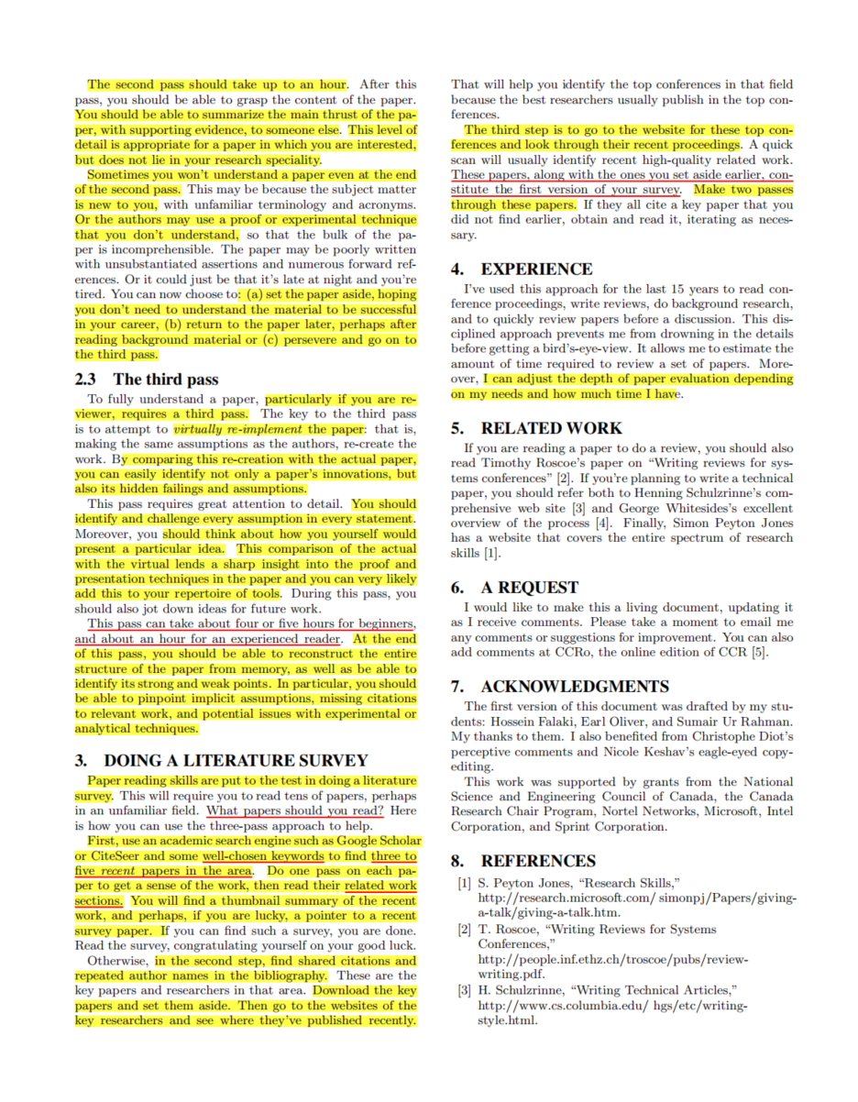
HowToReadPaper

Slide 32
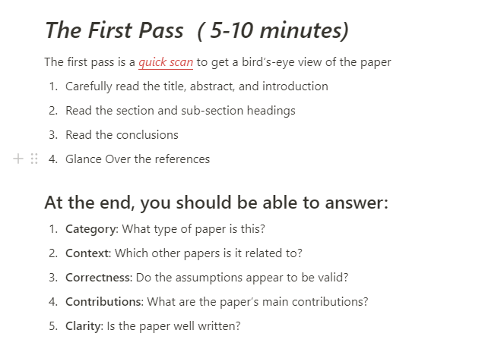
HowToReadPaper

Slide 33
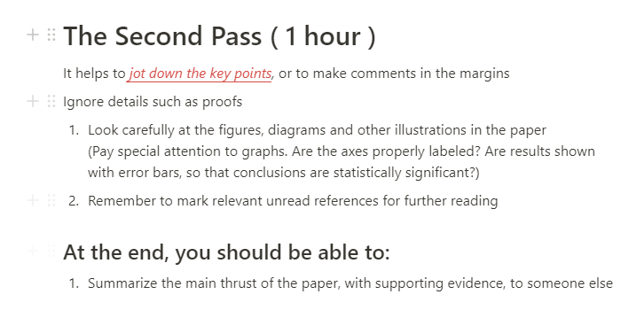

HowToReadPaper

Slide 34

HowToReadPaper

Slide 35

Notion

Slide 36



Notion
Pass One

Slide 37


Notion
Pass Two
Pass Three

Slide 38


Notion

Slide 39



Notion

Slide 41
f

